Slide 1


Team 20: 3-Phase Matrix Converter
Bi-Weekly Update 3 Chase Barnes, Daniel Loeza, Shanelle Algama Sponsor: Dr. John Lusher TA: Rhett Guthrie
Notes:
Michelle

Slide 2
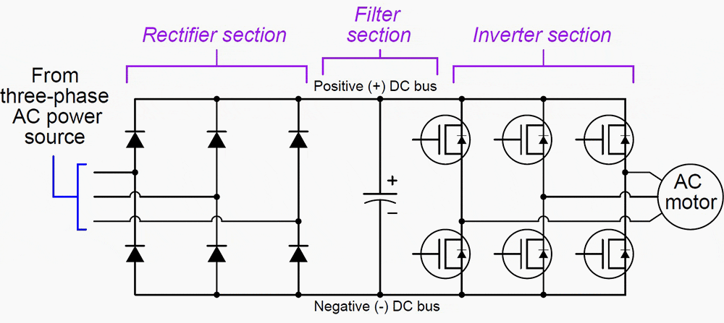
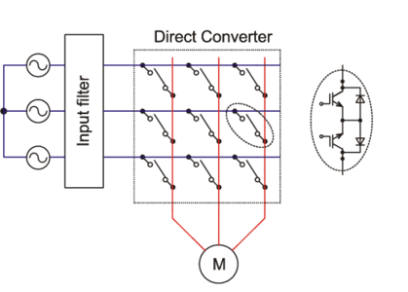
Project Summary
Traditional Variable Frequency Drives utilizes AC-DC-AC conversion:
Decreased efficiency across power output, and increased harmonic distortion.
3 Phase Matrix Converter utilizes AC-AC conversion:
Reduced efficiency loss across components.
Notes:
Barnes

Slide 3
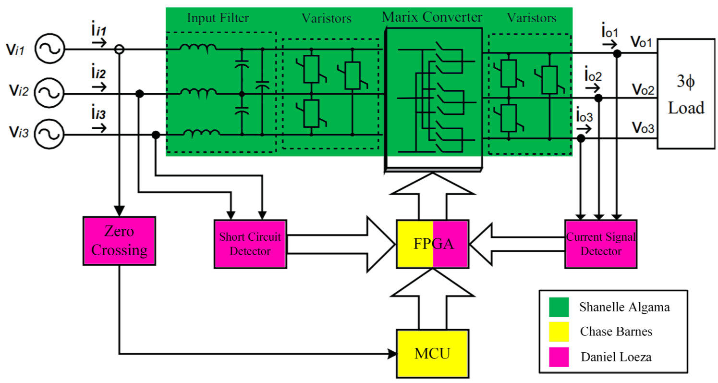
Project/Subsystem Overview
Bidirectional Switch subsystem
Creation of bidirectional switches with associated input filtration
Pulse Generator subsystem
Control board for sensing and communication to bidirectional switches
Firmware subsystem
Software for microcontroller, FPGA

Slide 4
Project Timeline
September 19 - Pulse Generator PCB will be assembled.
September 30 - Full Matrix of Bidirectional Switches will be assembled
October 7 - Pulse Generator and Matrix Converter Subsystems will be validated and functional.
October 7 - Full System Integration will begin.
November 11 - System will be validated and functional.
November 21 - Final Demo
Notes:
Eric

Slide 5
Firmware Subsystem
Chase Barnes
Accomplishments since last update 15 hrs of effort | Ongoing progress/problems and plans until the next presentation
MC SVM Functional | Finish up refactor for MC Finish Integration with Pulse Generator

Slide 6
Firmware Subsystem
Chase Barnes
Demonstration of Matrix output and frequency change

Slide 7
Matrix Converter Subsystem
Shanelle Algama
Accomplishments since last update 9 hrs of effort | Ongoing progress/problems and plans until the next presentation
-Several PCBs have been soldered -Ordered and received parts that were missed from the last order -Tried fixing a slight design error with the mill at FEDC but did not resolve problem | -Finish validation testing on the bidirectional switch -Solder remaining matrix once validation is completed and assemble boards -Validate Input and Output Boards

Slide 8
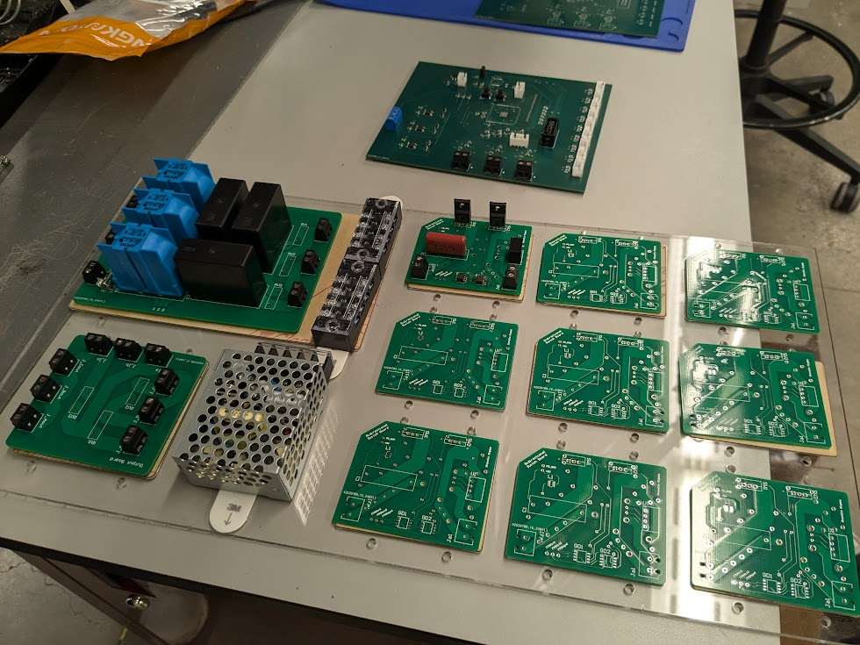
Matrix Converter Subsystem
Shanelle Algama

Slide 9
Pulse Generator Subsystem
Daniel Loeza
Accomplishments since last update 20 hrs of effort | Ongoing progress/problems and plans until the next presentation
PCB has been soldered. Current Sign Sensors have been mostly validated. | Issues with zero crossing sensor validation with equipment in lab. Intend to resolve this and begin integration with Firmware subsystem ASAP. Missing trace and components found on original board; new board was ordered and will be used for integration.

Slide 10
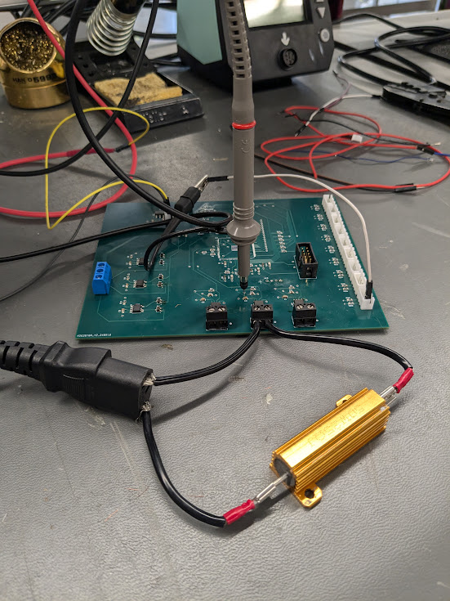
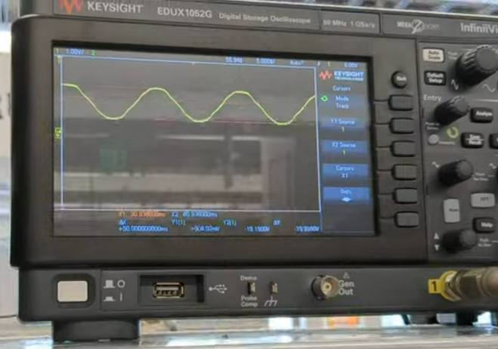
Pulse Generator Subsystem
Daniel Loeza

Slide 11
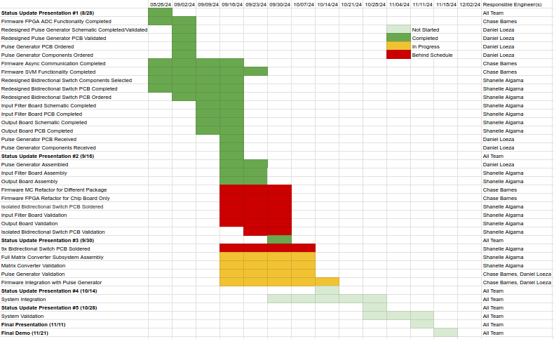
Execution & Plan
Notes:
Michelle

Slide 12
Thanks, and Gig ‘em!

